Slide 1


SAP FULL-STACK DEVELOPER TRAINING
ABAP on HANA, UI5 & Fiori, Analytics with OData
Anubhav Oberoy
Day – 3

Slide 2

Agenda – Day 3
Binding in SAP UI5
Expression Binding
Binding Modes
Aggregation Binding
Element Binding
Resource Model
--Break--
Formatter in SAP UI5

Slide 3

Binding in SAP UI5
Data binding is the process that establishes a connection between the application UI and business logic.
It is a bridge between a binding target and a binding source.
Sap ui5 provides three binding options
Property Binding
Expression Binding
Aggregation Binding
Element Binding
Property Binding:- When we bind property of a UI control, to the address of the model, this is called property binding. E.g. value property of Input control was connected to /emp/empId
Exercise code:

Slide 4

Expression Binding
Expression binding : - When we bind an Expression ({= condition ? true : false}) with the property of a control rather binding value to a property, this is called expression binding.
If we need some calculation on model data or some sort of comparison, then expression binding is useful.
Syntax:
numberState = “{= ${path} > value ? ‘conditionForTrue’ : ‘ConditionForFalse’ }”
Use Case of Expression Binding
My Manager want to add a button and when we click on that button, all the fields should gray out.
If The Employee Name is Anubhav, Gray out Salary field.
Condition – if employee name = Anubhav
Outcome – make field gray out
Target – Salary field
Exercise Code:

Slide 5
Binding Modes
There are basically three modes of binding data in SAPUI5.
One-way binding – Here, the data is transported in one direction only, i.e. from the model, through the binding instance to the consumer (usually the property of a control), but never in the other direction. Any change done on the model data from the front end is not affected to the model. All the data changes are reflected only on the controls.
Two-way binding – Here all input changes done from front end controls are reflected on the model and the backend database. SAPUI5 automatically handles the transport of data both from the model to the controls and back from the controls to the model.
One-time binding – Here all data will be bound from model to view just once. After that, the connection is no more set.

Slide 6
Aggregation Binding
When we bind the aggregation of a control with the entityset of data model, it is called aggregation Binding.
The parent control (e.g. Table) is bound to the EntitySet path which is called absolute path and the child of the parent Control (e.g. Columns) are connected to the child properties of the EntitySet is called relative path.
In aggregation binding, based on your model data, as many child controls will be created automatically.
Every Event of UI5 will trigger the eventHandler and we will get the Event Object as part of the event Handler. Depending on the event, the event handler object will have different parameters.
Use Case of Aggregation Binding
If we want to show a list or some data in tabular format, we need to bind a group of data. In such a case we will use aggregation binding.
Absolute path
{
“empTab”: [
{
“empId”: 50,
“empName”: “Jay”,
“salary”: 9500
}
]
}
Table = {/empTab}
Emp Id | Emp Name | Salary
{empId} | {empName} | {salary}
Relative Paths

Slide 7
Exercise
Aggregation Binding Exercise:

Slide 8
Element Binding
Element binding is useful for containers and layouts containing other controls. All these child controls would be required to use properties of the same model object or model node, then element-binding is preferable.
An element to be bound to an object in the Model can be achieved by Element binding.
Table
Emp Id | Emp Name | Salary
{empId} | {empName} | {salary}
/empTab/0
/empTab/1
/empTab/2
Element 0
Element 1
Element 2
Simple Form
Field 0
/empId
All the content of Row 1 in the table is bind to all the fields in the form
/empName
Field 1
Field 2
/salary

Slide 9
Exercise
Element Binding Exercise:

Slide 10
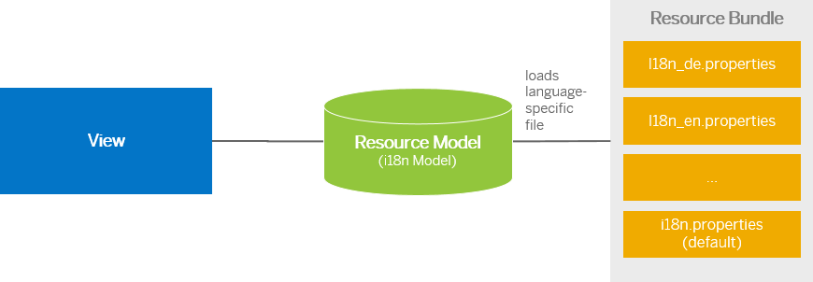
Resource Model
We build software for international audience, we cannot just hardcode every screen element in English, if it requires multi-lingual support, we need to add resource model.
i18n → Internationalization
Create resource bundle which includes label field
The name of the file must be i18n.properties for default labels
And i18n_langcode.properties for different languages
Set The model
For more information about i18n you check the link
https://openui5.hana.ondemand.com/1.34.9/docs/guide/831039835e7c4da3a8a0b49567573afe.html
Exercise Code:
-

Slide 11

Break

Slide 12
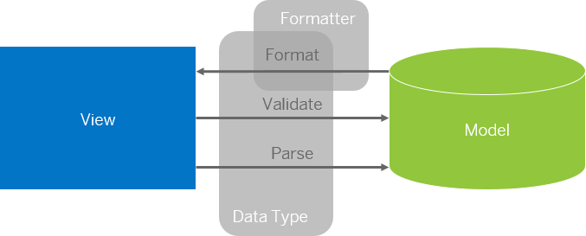
Formatter in SAP UI5
Formatters are used to define the formatting of data on the UI while data types work in both directions: they format the data on the UI and parse and validate user input that is entered.
Formatter is a function, This function gets called JUST Before the binding takes place with the view.
Exercise code:
-

Slide 13
Layouts in SAP UI5
Vertical Layout and Horizontal Layout
Simple way to align multiple controls vertically or horizontally.
Content controls within the layout.
All controls inside are not enabled automatically.
Content width is used as default width.
There is no default scrolling inside the layouts.
Field 1
Field 1
Field 1
Field 1
Field 1
Field 1
Field 1
Horizontal Layout
Vertical Layout

Slide 14
Title
Content
https://experience.sap.com/fiori-design-web/flexible-column-layout/
https://experience.sap.com/fiori-design-web/floorplan-overview/
http://sapui5starter.blogspot.com/2018/03/various-layouts-in-sapui5.html

Slide 15
Title
Content

Slide 16
Title
Content

Slide 17
Title
Content

Slide 18
Title
Content

Slide 19
Title
Content

Slide 20
Title
Content

Slide 21
Title
Content

Slide 22

End of Day 3

Slide 23

Questions

Slide 24

Anubhav Oberoy

Slide 25


We’re committed to empower you to be
Most Desirable Resource
through powerful training solutions.
We build the workforce of the future.
250+
Corporate Clients
30,000+
Learners Trained
25000+
Learners Placed
FREE WEBINARS
Sign up for free webinars with industry experts every fortnight!
Enroll Now!
Contact us today!
https://anubhavtrainings.com/

Slide 26




More from AnubhavTrainings.com

